Slide 1
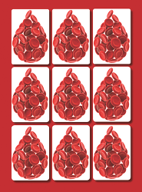
Blood Transfusions in the ED
Presented by: Terri Eckert, RN, BSN

Slide 2
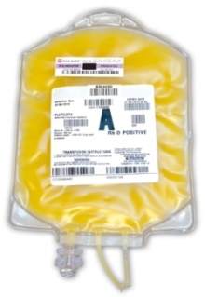
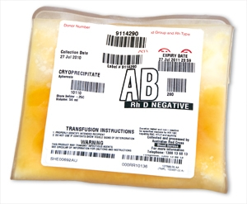
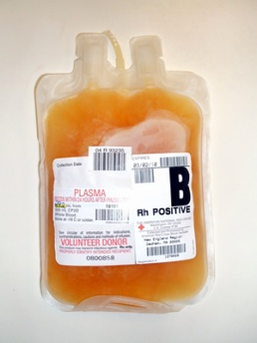
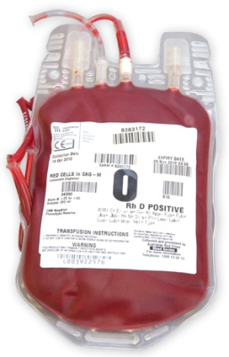
At the end of the lecture, the participate will BE ABLE to:
Objectives:
    Identify various types of blood and blood products and the reasons for their administration to a patient
    Identify the risks of blood transfusion
    Identify the essential steps necessary in the safe administration of blood and blood products to a patient
    Discuss nursing interventions for the patient with a transfusion reaction
    State indications for initiating the massive blood transfusion protocol and set up the Ranger blood warmer to correct hypothermia

Slide 3
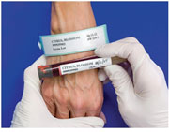
Blood Transfusions are relatively safe, but can be fatal if incorrectly administered
Critical points where errors occur most frequently:
  • Patient identification.
  • Sampling/labeling of the pre-transfusion specimen.
  • Removal of blood from the blood fridge before transfusion.
  • Checking the identification of both the patient and the blood component at the bedside.

Slide 4
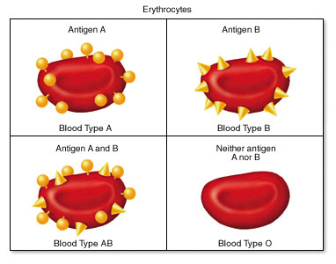
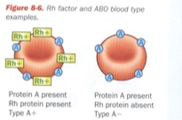
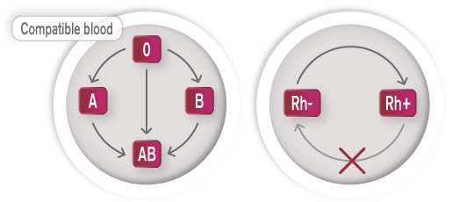
PATIENT SAFETY GOAL
GETTING THE RIGHT BLOOD, TO THE RIGHT PATIENT, EVERY TIME
  ABO blood system
      O can only receive blood from: O
      A can receive blood from: A and O
      B can receive blood from: B and O
      AB can receive blood from: AB, A, B and O
  Rh blood system
      Rh+ can receive blood from: Rh+ and Rh-
      Rh- can receive blood from: Rh-
Blood Type & Rh:
Mismatch leads to hemolysis
Notes:
ABO Blood Types: ABO (Blood is typed (or grouped) according to the surface antigens found mainly on red cells. Since there are hundreds of antigens found on all types of blood cells, there are a number of ways to group blood.)
Universal Donor=O negative
Universal Recipient=AB positive
Rh factor (positive or negative)
www.modernmedicine.com/modern-medicine/news/your-guide-safe-transfusions#1The ABO system determines an individual's overall blood type. If, for instance, a patient has type A blood, it means he has the surface antigen A on his red cells. And because nearly everyone develops antibodies to the ABO antigens they lack, he will also have anti-B antibodies in his plasma.⁶ (See the box below titled "Blood typing and compatibility").
If he's then given a blood transfusion of type B blood, his life is in immediate danger of an acute hemolytic reaction within minutes of receiving the first few milliliters of incompatible blood. That's because his immune system will identify the donor blood as foreign, and his anti-B antibodies will attack the donor cells. And, if whole blood is used, donor plasma anti-A antibodies will attack the patient's red cells. The result: the red cells will clump together (agglutinate) and then break down (hemolyze), triggering shock, intravascular coagulation, and renal failure.⁷ The reaction is usually fatal.
Acute hemolytic reaction can also occur because of Rh incompatibility. The Rh system includes about 50 different surface antigens, the most important of which is Rh-D.⁸ The presence of Rh-D means that the person is Rh-positive. Since 85% of the population has the Rh-D antigen,⁸ you don't hear much about incompatibility until someone who is Rh-negative is given a dose of Rh-positive blood.
The hemolysis, in this case, occurs extravascularly, triggering the coagulation cascade and the release of vasoactive agents that together bring on cardiorespiratory arrest.^{7,8} Fortunately, an Rh-hemolytic reaction can be stopped by giving Rh immune globulin (RhoGAM).⁸
- See more at: http://www.modernmedicine.com/modern-medicine/news/your-guide-safe-transfusions#1
The four common blood groups in the ABO/ABH system are O, A, B, and AB. These occur in the Caucasian population at frequencies of 45, 40, 11, and 4 percent, respectively [4]. These percentages vary somewhat among different ethnic groups. The function of the ABH antigens is unknown.
Natural alloantibodies — When an individual lacks the A and/or B antigen on the red cells, the plasma will contain naturally-occurring antibodies to the missing antigen(s). They generally appear in the blood by four to six months of age following exposure to bacterial antigens that are similar in structure to the A and B blood group antigens as the gut becomes colonized in early infancy [5]. Thus:
Group A individuals will have anti-B antibodies
Group B individuals will have anti-A antibodies
Group O individuals will have both anti-A and anti-B antibodies
Group AB individuals will have neither anti-A nor anti-B
(UpToDate)

Slide 5

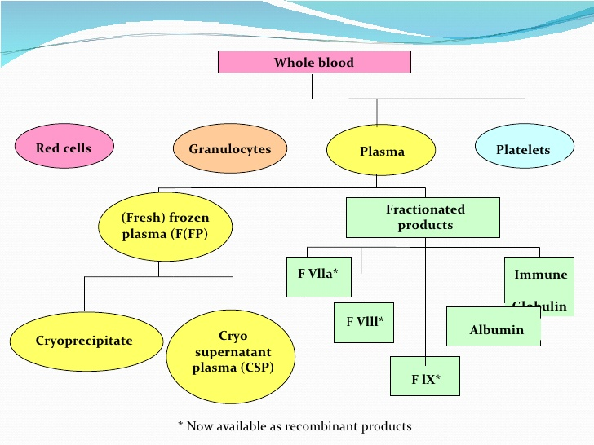
Many types of transfusable products can be derived from one unit of whole blood:
Notes:
Blood Management Principles?

Slide 6
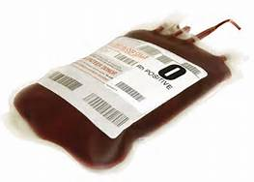
RBCs
RBCs: Packed, washed, irradiated
Indication: To increase the oxygen-carrying capacity in anemic patients. Used for volume and hemodynamic stability in actively bleeding patients.
Must be ABO compatible
70% Hct in pRBC compared to 40% Hct in whole blood
Transfusion trigger: Hgb 7, or case specific with Hgb 7-10 in patients with ischemic heart disease
Each unit increases Hgb by 1 gram/dl and increases hematocrit by 3%
Transfusion rate is per patient’s tolerance, less than 4 hours, with blood-y transfusion filter.
“RBC transfusion is indicated only for symptomatic anemia or a critical oxygen-carrying deficit”

Slide 7

Fresh Frozen Plasma (FFP)
FFP
Plasma
Indications
Reverse effects of Coumadin- If time allows use Vit. K first (6-8 hours)
Additional Information
FFP is stored in frozen state for up to 1 year-thawed in water bath
Use standard blood filter, prime with NS
Water- 92%
Vital Proteins - 7 % (Albumin, gamma globulins, AHF, & other clotting factors)
Mineral salts
Sugar
Hormones
Fat
Vitamins
Massive blood transfusions
Coagulation factor deficiencies for which no specific plasma concentrate exists
Management of bleeding patients with DIC & liver disease
Treat bleeding & correct clotting factor deficiencies
Do not use for volume expansion when blood volume can be replaced safely with other volume expanders (NS)
Must be ABO compatible, but not Rh compatible
Type AB-positive plasma can be transfused to patients of all blood types
1%
Lab to monitor:
PT/INR
Mammoth Hospital Blood Bank has 8 units of FFP available
Notes:
Indications: To prepare for invasive procedures, treat bleeding & correct clotting factor deficiencies
Preoperative or bleeding patients who require replacement of multiple plasma coagulation factors (dilutional coagulopathies)
Patients with massive transfusion who have clinically significant coagulation deficiencies
Patients on warfarin who are bleeding or need to undergo invasive procedure before Vit K could reduce effect
Patients with thrombotic thrombocytic purpura (TTP)
Patients with coagulation factor deficiencies for which no specific plasma concentrates are available

Slide 8

FFP Compatibility Chart
Plasma has ABO antibodies, so must be ABO compatible with recipient
DONOR
Good for all blood types
R
E
C
I
P
I
E
N
T
 | A | B | AB | O
A
B
AB
0
Rh Compatibility: Not an issue. Plasma products have no RBCs.

Slide 9

Platelets
Platelets
Indications
Additional Information
Compatibility testing is not necessary. May transfuse pt. with any type of blood group. Exception: Should be ABO compatible with recipient in infants or with large volumes of transfusion.
For actively bleeding patients with thrombocytopenia.
Prevention of spontaneous bleeding
Usual adult dose is 4-8 units.
Start slow, then transfuse as fast as tolerated, must be less than 4 hrs.
Lifespan of transfused platelets = 3-4 days
Platelets are transfused in preparation for invasive procedures
Massive blood loss (1:1:1 ratio) RBCS, FFP, Platelets
Goal: Transfuse immediately to keep platelet levels above 50,000 in most bleeding situations and 100,000 in patients with DIC or CNS bleeding.
Mammoth Hospital Blood Bank has NO platelets available
Use NEW standard blood tubing for transfusion
Leukocyte Reduced Platelets
Pooled Platelets (6 pack)
Single Donor Platelets (Apheresis) = 6 units
Platelets
Reno
Platelets are stored at room temperature= increased chance for bacterial growth
Normal platelet count=150,000-400,000
Notes:
Platelets are frequently the culprit. That's because platelets are stored at 68? – 75? F (20? – 24? C), a temperature warm enough to foster bacterial growth.5,9 For this reason, the American Association of Blood Banks' standards now require blood banks to check platelets for bacteria before releasing them for transfusion - The color of platelets should be yellow to light strawberry. There should be no visible clumps. Platelets should not be transfused in same filter after RBCs transfusion. Platelets can become trapped in the red blood cell debris left in filter. Microaggregate filters can filter out platelets, making the transfusion ineffective.
Pooled platelets — A single unit of platelets can be isolated from every unit of donated blood, by centrifuging the blood within the closed collection system to separate the platelets from the red blood cells (RBC). The number of platelets per unit varies according to the platelet count of the donor; a yield of 7 x 10¹⁰ platelets is typical [1]. Since this number is inadequate to raise the platelet count in an adult recipient, four to six units are pooled to allow transfusion of 3 to 4 x 10¹¹ platelets per transfusion [2]. These are called whole blood-derived or random donor pooled platelets.
Advantages of pooled platelets include lower cost and ease of collection and processing (a separate donation procedure and pheresis equipment are not required). The major disadvantage is recipient exposure to multiple donors in a single transfusion and logistic issues related to bacterial testing.
Apheresis (single donor) platelets — Platelets can also be collected from volunteer donors in the blood bank, in a one- to two-hour pheresis procedure. Platelets and some white blood cells are removed, and red blood cells and plasma are returned to the donor. A typical apheresis platelet unit provides the equivalent of six or more units of platelets from whole blood (ie, 3 to 6 x 10¹¹ platelets) [2]. In larger donors with high platelet counts, up to three units can be collected in one session. These are called apheresis or single donor platelets.
Advantages of single donor platelets are exposure of the recipient to a single donor rather than multiple donors, and the ability to match donor and recipient characteristics such as HLA type, cytomegalovirus (CMV) status, and blood type for certain recipients. (See 'Ordering platelets' below.)
Issues related to the effects of platelet pheresis on the donor are covered elsewhere. (See "Procedures used for blood donor screening: Protection of potential blood donors and recipients", section on 'Apheresis platelet donors'.)
Both pooled and apheresis platelets are contaminated with some white blood cells (WBC) that were collected along with the platelets. These WBC can cause febrile non-hemolytic transfusion reactions (FNHTR), alloimmunization, and transfusion-associated graft-versus-host disease (ta-GVHD) in some patients. (Uptodate)

Slide 10

Cryoprecipitate
Cryoprecipitate contains blood clotting proteins:
FFP is thawed and a precipitate is removed from the top - this is cryoprecipitate. Contains von Willebrand factor, factor VIII, XIII, fibrinogen, and fibronectin
One unit of cryoprecipitate will increase fibrinogen concentration by 50mg/dL
Indications:
Patients with von Willebrand’s Dz unresponsive to Desmopressin
Bleeding patients with vWD
Bleeding patients with fibrinogen levels < 80-100mg/dL
Hemophilia A
Administer rapidly through a standard blood filter
ABO compatibility preferred
Cryo is not stocked at M.H. It must come up from NIH, Bishop
Fibrinogen: 150-400 mg/dL
Fibrinogen is vital to blood clotting.
Notes:
Fibrinogen: 150-400 mg/dL

Slide 11

What is a Blood Transfusion Reaction?
Any major change in a patient’s condition during and/or after a blood product transfusion. Changes warrant investigation…
SOB
Fever
HIves
Chest pain
Chills
Back pain
Tachycardia
Rash
hypotension
Notes:
Untoward effects of blood transfusion are not unexpected and in many cases are benign. However, some reactions cause serious morbidity and may be fatal [1]. The problem is that the initial symptoms of reactions with serious or relatively benign consequences are often similar. (UptoDate)
Most transfusion reactions are diagnosed by exclusion; thus, any significant change in a patient's condition during transfusion should prompt an investigation. Successful investigation of a transfusion reaction depends on detailed observation, documentation and reporting of the patient's vital signs, before and after the transfusion, and the signs and symptoms that prompted the investigation. (What every physician should know about a blood transfusion)

Slide 12
IMMEDIATE IMMUNOLOGIC
TRANSFUSION REACTIONS
Acute hemolytic transfusion reaction (AHTR)
Febrile non-hemolytic transfusion reaction (FNHTR)
Allergic reaction
Anaphylactic reaction
Transfusion related acute lung injury (TRALI)
AHTR
FNHTR
Anaphylactic Reaction
Allergic Reaction
TRALI
IMMEDIATE IMMUNOLOGIC TRANSFUSION REACTIONS

Slide 13
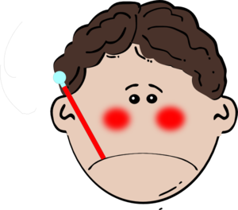

Febrile Non Hemolytic Reactions
Fever
Chills
Rigors
Mild dyspnea
Anxiety
Most common transfusion reaction:
2 degree F unexplained rise in baseline temperature during or shortly after the transfusion
Platelets are often the culprit and leukocytes
Often caused by cytokines produced during blood collection and storage
**Stop the transfusion. Rule out sepsis & hemolytic reaction
Treatment: Treat the symptoms (Tylenol & Demerol). Pre-medicate with antipyretics and use leukoreduced components in subsequent transfusions
Notes:
Most common in pregnant patients, patients who have had previous transfusions, and patients that receive platelets. Less common with apheresis platelets than pooled platelets. Risk is small with components with that don’t contain WBCs (FFP, Cryo, and factor concentrates)
Platelets, more often than red blood cells, are the cause of febrile nonhemolytic transfusion reaction because they are stored at room temperature, which is conducive to leukocyte activation and cytokine accumulation. When caused by red blood cells, febrile nonhemolytic transfusion reactions are usually mediated by recipient antibodies against donor leukocytes; therefore, removing leukocytes from blood products before transfusion can reduce this type of reaction.
Cytokines=intercellular chemical messenger released by white blood cells

Slide 14
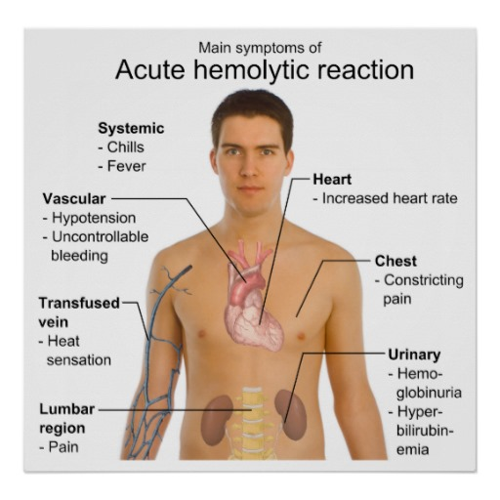
Hemolytic Reactions
1/77,000 units - Clerical error
Can occur after only 5-20 mls of blood
ABO/Rh Mismatch: Antibodies in recipient’s plasma react against antigens on donor’s RBCs
Rapid intravascular hemolysis of donor RBCs -
Complications: Hemoglobinemia, hemoglobinuria, DIC, renal failure, and cardiovascular collapse
Tx/Support: Fluid/vasopressors/airway/manage
DIC

Slide 15
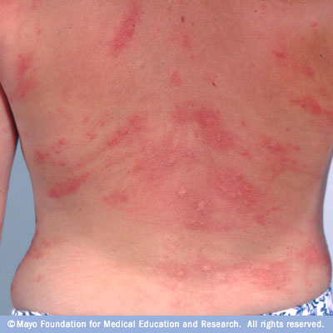
Allergic/
Anaphylactic Rxs
Allergic Reactions: Common
  Most classic symptom= Hives
  Itchy skin
  Wheezing
  Swelling of face, lips, throat
Anaphylactic Reactions: Rare
Mild cough
Severe hypotension or shock
Chills
Tachycardia
SOB, bronchospasm, tightness in chest
N/V/D, abdominal cramps
Hives, flushed skin
Anxiety, ALOC
  Recipient is overly sensitive to the plasma proteins in the blood component
These reactions have been reported in IgA-deficient patients who develop antibodies to IgA antibodies.
Treatment:
  Stop the transfusion
  Oxygen
  Antihistamines (Benadryl)
  Epinephrine and corticosteroids

Slide 16
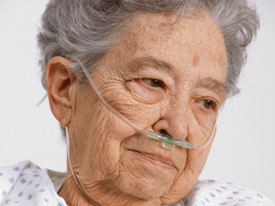
TACO (Transfusion Associated Circulatory Overload)
T
Tachypnea
Orthopnea
Pulmonary edema
Cyanosis
Systolic hypertension
Peripheral edema
S3 on auscultation
Increased jugular distention
NO FEVER
Circulatory system is unable to deal with a sudden increase in blood volume
Risk factors:
  Cardiac disease, renal disease, elderly, neonates
  Large volumes
  Rapid transfusion
Treatment:
  Slow down the transfusion
  Lasix between units
  Oxygen & mechanical ventilation, if necessary
Notes:
No fever and hypertension

Slide 17

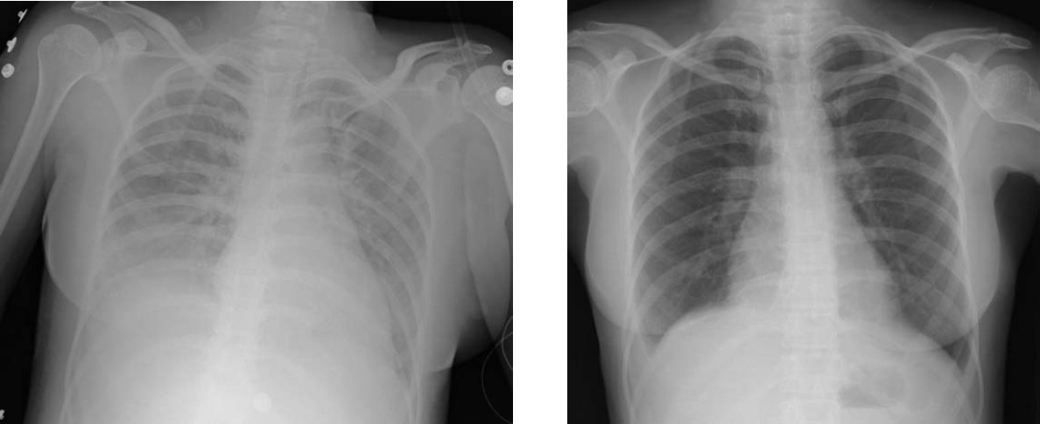
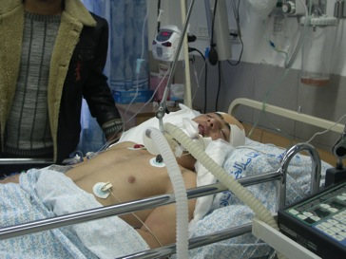
TRALI (Transfusion Related Acute Lung Injury)
TRALI: Caused by inflammatory immune response
Uncommon, but can be fatal
WBC antibodies in donor’s blood react against recipient's WBCs.
WBCs clump in pulmonary capillaries & cause lung damage
Primarily FFP, but can occur with all types of blood products
Onset: During or within 6 hours after transfusion
Symptoms:
Acute onset hypoxemia
Non-cardiogenic pulmonary edema
Fever, tachycardia & hypotension
Treatment: Stop the transfusion. Aggressive respiratory support, often mechanical ventilation & diuretics. Prevention: Leukocyte reduction & avoid multiparous plasma donors
CXR usually improves within 96 hours
Immediate immunologic transfusion reaction
Notes:
Various stimuli in blood components, most commonly white blood cell (WBC)
antibodies from donors sensitized during pregnancy or prior transfusion or
transplantation, or proinflammatory molecules that accumulate in stored blood
components, may cause TRALI
Inflammatory immune response
Usually patients are ex-tubated within 48 hours
Prevention:
Transfusion-related acute lung injury (TRALI) is characterized by the acute onset of
hypoxemia and noncardiogenic pulmonary edema within 6 hours of a blood or blood
component transfusion in the absence of other causes of acute lung injury or circulatory
overload. Various stimuli in blood components, most commonly white blood cell (WBC)
antibodies from donors sensitized during pregnancy or prior transfusion or
transplantation, or proinflammatory molecules that accumulate in stored blood
components, may cause TRALI. These mechanisms may not be mutually exclusive and
may act synergistically with underlying patient factors to lead to a final common pathway
of acute lung injury. These stimuli may trigger an inflammatory response, granulocyte
activation and degranulation, and injury to the alveolar capillary membrane, and the
development of permeability pulmonary edema. Although most TRALI cases are Circular of Information for the Use of Human Blood and Blood Components 5 associated with donor antileukocyte antibodies, rare cases have implicated recipient
antileukocyte antibodies that reacted with donor leukocytes. Widespread leukoreduction
of blood components has likely mitigated this latter risk. Laboratory testing of blood
donors for antileukocyte antibodies or blood components for biologic mediators does not
alter management of this reaction, which is diagnosed on clinical and radiographic
findings. Treatment of TRALI involves aggressive respiratory support, and often
mechanical ventilation. The preferential use of plasma collected from male donors has
been associated with a significant reduction in the number of reported TRALI cases and
associated fatalities. Transfusion services should immediately report suspected TRALI to
the blood collection facility to facilitate the retrieval of other components associated with
the involved donation(s) or prior donations. (AABB)
Transfusion-related acute lung injury (TRALI) is a rare but potentially fatal complication of blood product transfusion. TRALI has been defined by both a National Heart, Lung, and Blood Institute (NHLBI) working group as well as a Canadian Consensus Conference, as new acute lung injury (ALI)/acute respiratory distress syndrome (ARDS) occurring during or within six hours after blood product administration (table 1) [1,2]. When a clear temporal relationship to an alternative risk factor for ALI/ARDS coexists, a formal diagnosis of TRALI cannot be made. In these circumstances, the diagnostic terminology to be used is “possible TRALI.” Prior to the institution of TRALI risk mitigation strategies, plasma components and apheresis platelet concentrates conferred the highest risk of TRALI per component. Currently, due to transfusion of a much larger number of red cell units compared with plasma and platelets, the largest number of TRALI-related deaths in the United States and other developed countries occur with red blood cell transfusion [3]. (See 'Prevention' below.) Historical estimates suggest that TRALI occurs at a rate of approximately 0.04 to 0.1 percent of transfused patients or in approximately 1 in 5000 transfused blood components [4-7]. However, the true incidence of TRALI is not known, largely due to poor syndrome recognition, the reliance on passive reporting rather than active surveillance strategies, and the inclusion of cases that did not meet the NHLBI or Canadian Consensus Conference definitions of TRALI in some reports [3,8-11]. Additionally, due to the contribution of specific recipient risk factors, TRALI incidence is also likely to depend on the population of interest. As an example, estimates suggest that the rate of TRALI in critically ill populations may reach 5 to 8 percent [12,13]. (See 'Recipient risk factors' below.
(Uptodate)

Slide 18
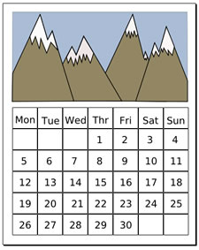
DELAYED IMMUNOLOGIC TRANSFUSION REACTIONS
Delayed Hemolytic Reaction
Alloimmunization
Post-Transfusion Purpura (PTP)
Transfusion-Associated Graft-vs-Host Disease (TA-GVHD)
2-14 days
RARE
RARE
First week-Several weeks
7-10 days
Notes:
Delayed hemolytic reactions occur in previously red-cell-alloimmunized patients in
whom antigens on transfused red cells provoke anamnestic production of antibody. The
anamnestic response reaches a significant circulating level while the transfused cells are
still present in the circulation; the usual time frame is 2 to 14 days after transfusion. Signs
may include unexplained fever, development of a positive DAT, and unexplained
decrease in hemoglobin/hematocrit. (AABB)
Posttransfusion purpura (PTP) is a rare syndrome characterized by the development of
dramatic, sudden, and self-limited thrombocytopenia, typically 7 to 10 days after a blood
transfusion, in a patient with a history of sensitization by either pregnancy or transfusion
Alloimmunization to antigens of red cells, white cells, platelets, or plasma proteins may
occur unpredictably after transfusion. Blood components may contain certain immunizing
substances other than those indicated on the label. For example, platelet components may
also contain red cells and white cells. Primary immunization does not become apparent
until days or weeks after the immunizing event, and does not usually cause symptoms or
physiologic changes.
Transfusion-associated graft-vs-host disease (TA-GVHD) is a rare but extremely
dangerous condition that occurs when viable T lymphocytes in the transfused component
engraft in the recipient and react against recipient tissue antigens

Slide 19
NON-IMMUNOLOGIC TRANSFUSION COMPLICATIONS
Infectious:
HIV, Hepatitis, Syphilis, CJD
CMV
Bacterial Sepsis
Transfusion Related Circulatory Overload (TACO)
Hypothermia
Metabolic Complications:
Citrate Toxicity,
Low Ionized CA++, Acidosis/Alkalosis,
+/-K
Notes:
Citrate “toxicity” reflects a depression of ionized calcium caused by the presence in
the circulation of large quantities of citrate anticoagulant. Because citrate is promptly
metabolized by the liver, this complication is rare.

Slide 20
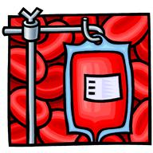
Transfusion Preparation:
  Order Type and Cross, if not previously ordered
  Verify doctor’s order , type of blood component, special requests,
  length of time for transfusion
  Obtain informed consent (Forms Fast)
  Provide pre-transfusion education
  Pre-medicate with Tylenol and Benadryl, if ordered
  Assemble equipment- NS and Y-Blood filter tubing (170-260 microns)
  Ensure a functional IV site
  Obtain the blood from blood bank- Bring pt.’s identification label to lab
  Preform baseline vital signs, patient’s history & physical assessment
  Blood and blood components may be warmed only via approved blood warming infusion devices per hospital policy
Blood and blood components may not be returned to the Blood Bank after 30 minutes of issue.
Notes:
Administer CMV-negative blood in patients who are immunocompromised
Follow protocol on administering blood transfusions
History of 2 previous febrile nonhemolytic reactions and in patients who frequently receive blood products administer leukocyte-poor packed RBCs
History of previous anaphylactic reactions to transfused blood, transfuse blood from IgA-deficient donors, or if this is not available, frozen deglycerolized packed RBCs
Irradiated blood should be given to immunocompromised patients, those receiving bone marrow transplants, and those receiving blood products from a blood relative donor. : Teach the patient about the procedure-associated risks and benefits, what to expect during the transfusion, signs and symptoms of a reaction, and when and how to call for assistance. Blood warmers are useful in patient’s that need large volumes of blood, or in shock. (Prevents arrhythmias & cardiac arrest) Assure that informed consent has been obtained before starting a transfusion. In many institutions this is obtained by the physician. Appropriate information to include in patient education includes the benefits, risks and alternatives to transfusion. Letting your patient know that transfusion is generally a safe and simple procedure is important and can help reassure a frightened patient, too. At the same time, patients should be told that reactions to blood components can occur. Instructing your patient to alert you to any unusual sensations he or she might experience during or after the infusion will help ensure that symptoms of a possible reaction are promptly reported. Document all patient education regarding transfusion therapy, and the responses of patients and family members after teaching.
When assessing your patient before a transfusion, you should obtain important medical history information, review pertinent lab values, and perform a physical assessment. Find out whether your patient has ever been transfused and if so, if he or she experienced any adverse reactions. A female patient’s history of pregnancy might indicate if a patient is more likely to experience a reaction due to previous sensitization by the father’s blood type being expressed in the fetus. A history of heart disease or renal disease may indicate the need for a slower rate of infusion. (A slower rate of infusion may also be necessary for geriatric or pediatric patients.)
Review the laboratory studies that prompted the transfusion order to double-check why the physician has ordered the transfusion. Reviewing the physician order, including any special processing requested, provides an opportunity to be sure the blood component was properly ordered and dispensed. The patient’s electrolyte and fluid balance should also be assessed.
A baseline physical assessment should include vital signs and assessment for skin rashes, shortness of breath, wheezing, pain, chills, itching or nausea. In patients with cardiopulmonary disease, listen to the lungs to establish a baseline for the presence of any rales (crackles).

Slide 21
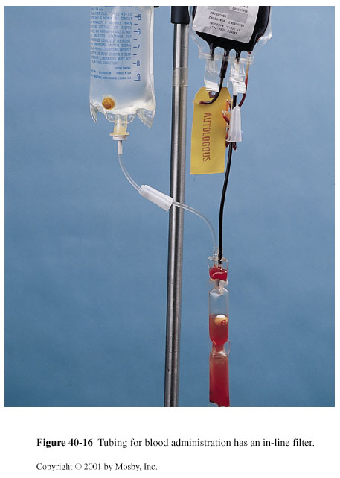
Blood Transfusion Administration
“A blood transfusion is a human tissue transplant”
Blood must be hung or returned to blood bank within 30 minutes of issue
Transfusion must be completed within four hours
Nothing other than 0.9% NS may be added to blood
No medications may be added to IV or blood unit
Do not piggyback blood into another IV line
Blood administration tubing may be used for two units or up to 4 hrs.
Start transfusion slowly: 25mls over first 15 minutes (100mls/hr.)
Watch closely. Stay with the patient for the first 15 minutes of the transfusion
If no reaction is noted, increase rate per patient tolerance
Take & document vital signs pre-transfusion, at 15 minutes, 30 minutes, 1 hour, 2 hours , 1 hour post transfusion, and as necessary
Document patient tolerance
Notes:
To minimize the risk of bacterial growth, the transfusion must be completed within 4 hours of removing it from refrigeration.

Slide 22

Two Nurse
Bedside Verification
Verify blood product matches physician order
Compare ‘Blood Transfusion Record’ to patient’s wristband. Have pt. state their name & date of birth. Verify match.
Compare and verify (‘Blood Transfusion Record’ to requisition/ tag attached to the unit of blood)
    Donor Unit Number
    Recipient Group & Rh
    Donor Group & Rh
    Expiration Date & Time
    Unit inspection: Ok? Yes or No
    Two signatures are required at the bottom of the ‘Blood Transfusion Record’ to certify the blood or blood component has been verified and is correct
If the blood bag label is incomplete, do not transfuse the unit.
Notes:
Invert bag and squeeze, check for leaks or missing ports. Check color, cloudiness, clumps

Slide 23

Mammoth Hospital Procedure for Transfusion Reaction
IF TRANSFUSION REACTION IS SUSPECTED:
  Stop the transfusion and notify physician stat
  Remove transfusion tubing (save) and hang new IV tubing with NS infusion
  At the bedside, check for possible clerical errors
  Notify the blood bank.
  Complete “Transfusion Reaction Report.” (Forms Fast)
  Order “Transfusion Reaction” on order entry (Draw one pink topped tube)
  Send first voided urine and again in 5 hours
  Document signs & symptoms
  Take & record vital signs Q 15 minutes until stable, then Q 2 hours x2, then Q 4 hours x 24 hours.
  Follow physician’s orders for case-specific interventions
Notes:
IF TRANSFUSION REACTION IS SUSPECTED:
Stop the transfusion and notify physician stat
Remove transfusion tubing (save) and hang new IV tubing with NS infusion
At the bedside, check all labels, forms & patient ID to determine if the correct patient received the intended component
Notify the blood bank. Complete “Transfusion Reaction Report.” Return unit with saline bag and tubing attached & completed “Blood Transfusion Record”
Order “Transfusion Reaction” & draw a new clot & lavender tube or one pink topped tube
Send first voided urine specimen to lab & again in 5 hours
Describe & document patient’s signs & symptoms fully in nurse’s notes
Take & record vital signs Q 15 minutes until stable, then Q 2 hours x2, then Q 4 hours x 24 hours.
Follow physician’s orders for treatment

Slide 24
After blood transfusion
Continue to monitor patient: Remember some transfusion reactions are delayed
Return empty blood transfusion units and yellow portion of the “Blood Transfusion Record” paperwork to the Lab in a bio- hazardous bag
Notes:
The surface antigens found on white blood cells, along with lesser known antigens on red cells and even those found on platelets, are responsible for most nonhemolytic reactions. Sensitivity often develops with multiple transfusions, or in those who are immunocompromised.6 - See more at: http://www.modernmedicine.com/modern-medicine/news/your-guide-safe-transfusions#sthash.W5kCIPh5.dpuf

Slide 25

Obtaining Blood / Blood Components After-hours
Blood bank is not staffed from 2300-0600
  Call in Lab Specialist
  Nurse & one other employee may check out blood
  Obtaining access to blood bank
  Location of paperwork
  Location of cross-matched blood
  Care of the blood bank refrigerator
Notes:
After hours: The blood bank is not staffed from 2330-0600. Two options are available for obtaining blood/blood products after hours. 1) Call the on-call Clinical Laboratory Specialist to come in to assist with removal or 2) a nurse & one other employee may remove blood/blood product from blood bank. Double check blood/blood products per procedure. Access Lab by using name badge to swipe lock at door.
Both the Patient Transfusion Record and Blood Transfusion Record will be found on the table across from the blood bank refrigerator and must be completed prior to leaving the blood bank.
Crossmatched units are found on the top drawer of the blood bank refrigerator and are affixed with an identification tag.
Only a nurse should remove the unit from the blood bank refrigerator. The door must be closed firmly but not slammed; there is no mechanical latch. Ensure the door is closed securely before leaving the room.
Notify the laboratory ASAP after 0600 a.m. that the unit has been removed.

Slide 26
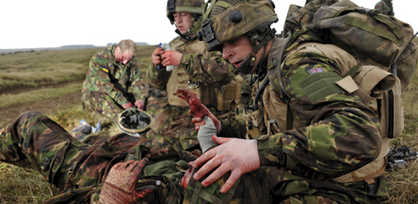
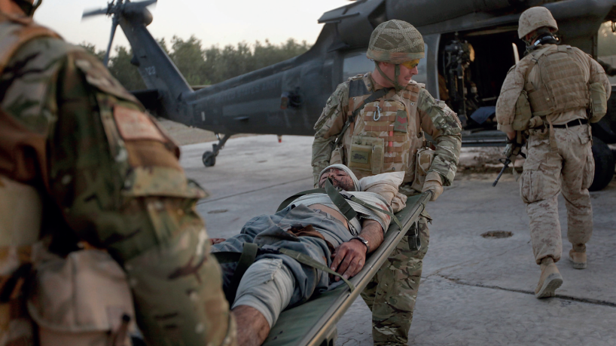
Massive Blood Transfusion
Definitions:
  the replacement entire blood volume within a 24 hour period
  transfusion of 10 units of red cells in a few hours
  or loss of 50% blood volume within 3 hours
  or loss of 150ml/min
Primary goals when managing traumatic shock are :
  Restoration of oxygen delivery to end organs
  Maintenance of circulatory volume
  Prevention of ongoing bleeding through source control
  Correction of coagulopathy
DAMAGE CONTROL RESCUSITATION
  • Early delivery of blood component therapy
    – pRBC
    – FFP
    – PLT
  • Permissive hypotension (sbp 90)
  • Minimal crystalloid based resuscitation
1:1:1
Notes:
 Coagulopathy
 Volume overload
 Hypothermia
 Hyperkalemia
 Metabolic acidosis and hypokalemia (citrate)
 Hypo calcemis due to citrate toxicity - especially
with hepatic failure, CHF, or other low-output
states

Slide 27
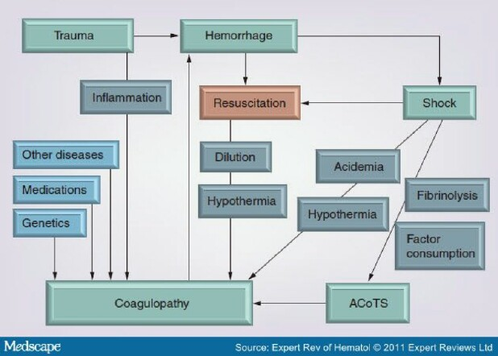
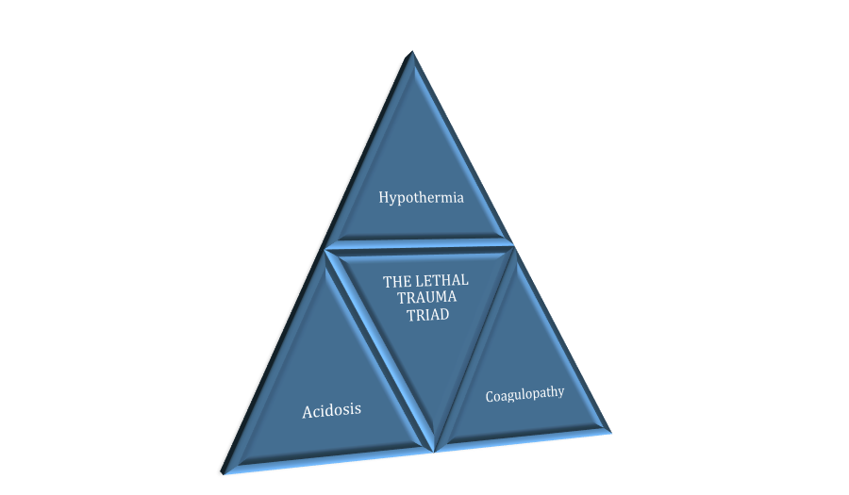
COMPLICATIONS OF TRAUMA
COMPLICATIONS OF Massive Blood Transfusions
Alteration in coagulation system
Acidosis
Hypothermia
Citrate Toxicity
Hyperkalemia
Hypocalcemia & alkalosis
Notes:
Citrates in blood products bind with calcium, increasing the risk of extreme hypotension and depressed heart function, so have a supply of calcium chloride on hand to prevent the low levels of ionized calcium that can occur after rapid transfusion.

Slide 28

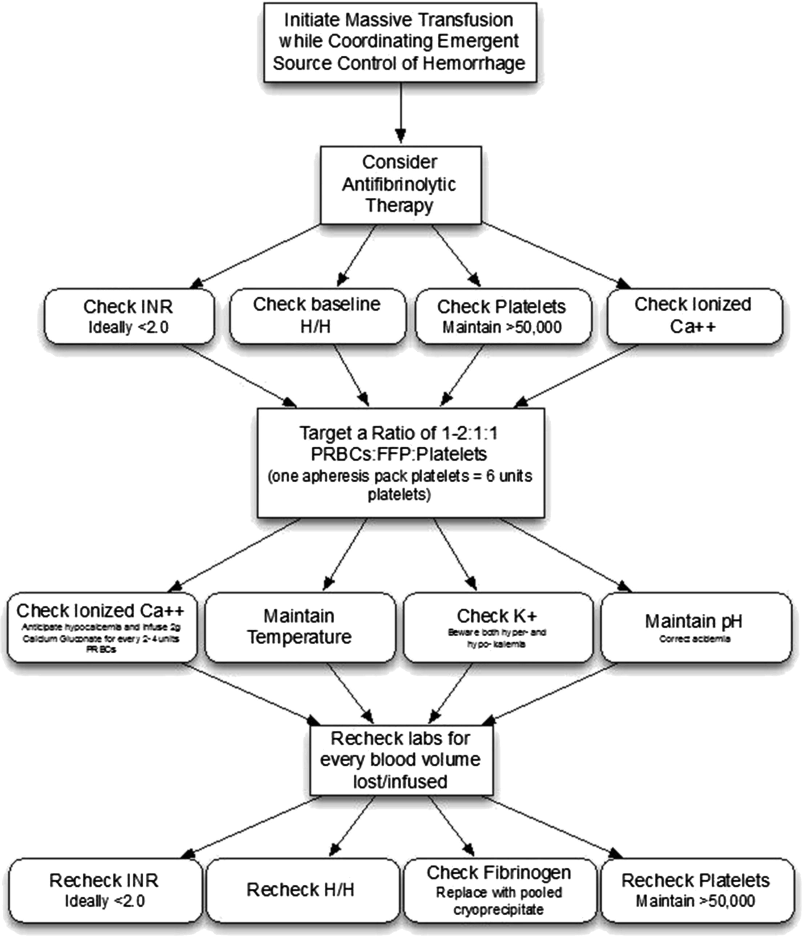
“OR” STAFF
Blood Bank/CHP
http://dx.doi.org/10.1016/j.jemermed.2012.11.025
Massive Blood Transfusion Protocol

Slide 29
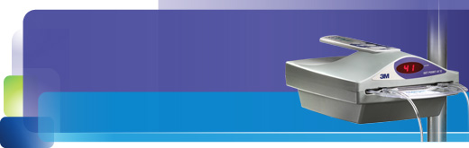

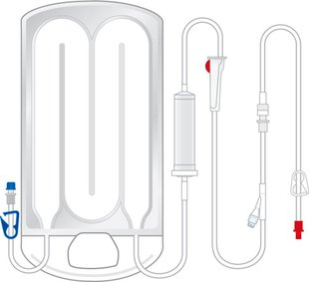
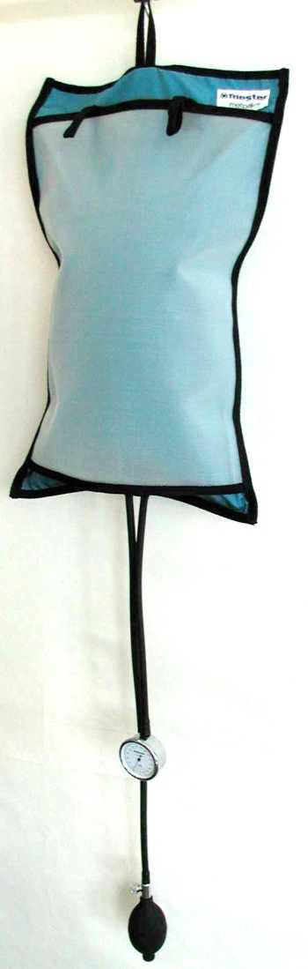
Even warming
No hot spots
3M Ranger “Dry Heat Technology” Warming System
Highly conductive aluminum heating plates
Insert warming cassette into Ranger slot before priming
Attach blood tubing & prime with NS
  Do not overfill blood filter
Turn unit on
Connect to patient
  Quickly adapts to changes
  KVO to 9L/hour
  Hi/Lo alarms
Invert bubble trap & fill completely
300mmHg
Max
Inlet
Label Up
Pt. side
Priming volume=44ml
Monitors temperature four times
each second and adjusts the heat
level to maintain a 41°C set point.
Remove cassette for transfers: Close inlet clamp, discard 2 ml of fluid from cassette & disconnect unit from patient

Slide 30
Questions?

