Slide 1
Introduction to Urology
Emily Marshall, PA-C, MPAP

Slide 2
Objectives
Upon completion of this lecture, nurses should have increased knowledge about epidemiology, symptoms, signs and treatment options for the following conditions:
Benign Prostatic Hyperplasia (BPH)
Prostate Cancer
Bladder Cancer
Pelvic Prolapse

Slide 3
Benign Prostatic Hyperplasia (BPH)
Noncancerous enlargement of the prostate gland
Hypertrophy of the cells (↑ in the number of cells, NOT growth in the size of the cells)
When significantly enlarged, the prostate compresses the urethral canal, causes obstruction of urine flow

Slide 4
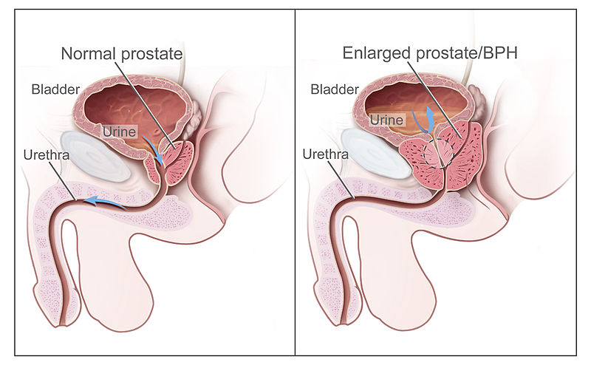
http://en.wikipedia.org/wiki/File:Benign_Prostatic_Hyperplasia_nci-vol-7137-300.jpg
http://en.wikipedia.org/wiki/File:Benign_Prostatic_Hyperplasia_nci-vol-7137-300.jpg

Slide 5
Signs/Symptoms of BPH
Obstructive: hesitancy, weak stream, straining to void, incomplete bladder emptying, prolonged urination, acute or recurrent urinary retention
Irritative: urgency, frequency, nocturia, urge incontinence

Slide 6
Epidemiology/Risk Factors of BPH
No racial differences
↑ age and normal androgen status are risk factors
An estimated 25% of males > 50 years old have symptomatic BPH
1st degree relatives of patients with early onset BPH have 4 x the risk for development of BPH

Slide 7
Complications of BPH
Urinary retention
UTI
Bladder calculus (stones)
Chronic or acute renal failure
Bladder diverticulum
Bladder dysfunction
Upper urinary tract obstruction

Slide 8
Medical Treatment of BPH
Alpha-1 Adrenergic Blockers: tamsulosin (Flomax), alfuzosin (Uroxatrol), doxazosin (Cardura), prazosin (Minipress), terazosin (Hytrin)
Mechanism of Action: relaxes smooth muscle of the bladder and prostate
Side Effects: orthostatic hypotension, dizziness, tiredness, retrograde ejaculation, rhinitis, headache

Slide 9
Medical Treatment of BPH
5-Alpha-Reductase Inhibitors: finasteride (Proscar), dutasteride (Avodart)
Mechanism of Action: decreases the epithelial component of the prostate, resulting in ↓ size of gland and improvement of symptoms
6 months of therapy required for maximal effects
Side Effects: ↓ libido, ↓ volume of ejaculate, impotence, reduction in serum PSA by 50%

Slide 10
Surgical Treatment of BPH
Transurethral resection of the prostate (TURP)
Transurethral incision of the prostate (TUIP)
Open simple prostatectomy
Laser therapy
Transurethral needle ablation of the prostate (TUNA)
Transurethral electro-vaporization of the prostate
Microwave hyperthermia

Slide 11
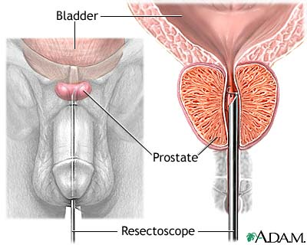
Transurethral Resection of the Prostate
http://www.bing.com/images/search?q=transurethral+resection+of+prostate+&view=detail&id=DB971AE5DB85690222613AB77144DF9F38D26452&first=1

Slide 12
Risks/Complications of TURP
Risks: incontinence (<1%), impotence (5-10%), retrograde ejaculation (75%)
Complications: bleeding, urethral stricture or bladder neck contracture, perforation of prostate capsule with extravasation, and if severe, transurethral resection syndrome

Slide 13
Transurethral Resection Syndrome
Hypervolemic, hyponatremic state resulting from absorption of hypotonic irrigating solution
Risk ↑ with resection times > 90 minutes
Symptoms/Signs: nausea/vomiting, confusion, HTN, bradycardia, visual disturbances
Treatment: diuresis and, in severe cases, hypertonic saline administration

Slide 14
Prostate Cancer
Most common cancer in American men
Incidence ↑ with age
A 50-year old American man has a lifetime risk of 40% for latent prostate cancer & a 2.9% risk of death due to prostate cancer
Risk Factors: Blacks, + Family Hx, ↑ fat intake
Most common site of metastasis is the axial skeleton, ↑ Alkaline Phosphatase

Slide 15
Symptoms/Signs of Prostate Cancer
Signs: prostate nodule found on digital rectal examination (DRE), ↑serum Prostate Specific Antigen (PSA)
Usually asymptomatic
Possible Symptoms: obstructive voiding symptoms, lower extremity lymphedema due to lymph node metastases, back pain or pathologic fx’s due to metastases, neurologic symptoms due to epidural metastases or cord compression

Slide 16
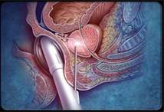
Prostate Biopsy
Transrectal ultrasound-guided biopsy is used to detect prostate cancer
http://www.bing.com/images/search?q=prostate+biopsy&FORM=HDRSC2

Slide 17
Prostate Cancer Pathology & Staging
Most prostate cancers are adenocarcinomas
Gleasons Score: five “grades” are possible
  A primary grade is applied to the architectural pattern of cancerous glands occupying the largest area
  A secondary grade is applied to the next largest area of cancerous growth
  Adding the score of the primary and secondary patterns gives a Gleason score

Slide 18
Gleasons Score Examples
5 + 5 most aggressive possible
4 + 3 fairly aggressive
3 + 3 moderate aggressiveness
2 + 3 fairly non-aggressive
1 + 1 very non-aggressive
Grades 4 and 5: ↑ risk of metastasis
Grades 1 and 2: usually confined to the prostate

Slide 19
Prostate Cancer Treatment Options
Active surveillance
Cryosurgery
Radical prostatectomy (open vs. robotic)
Radiation therapy
Androgen deprivation therapy (pharmacological or surgical orchiectomy)
Chemotherapy (last resort treatment)

Slide 20
Radical Prostatectomy
Removal of the seminal vesicles, prostate & ampullae of the vas deferens
After surgery, a foley catheter is left in place for 1-3 weeks and can only be removed when the surgeon decides; it cannot be changed or removed until the surgeon decides
Risks of Surgery: urinary incontinence, impotence & other surgery risks (bleeding, etc.)
Dry orgasms (sperm banking prior to surgery)

Slide 21
Cryosurgery of the Prostate
Liquid nitrogen is circulated through small hollow-core needles inserted into the prostate under ultrasound guidance
Leads to tissue destruction
Great choice for aggressive, localized prostate cancer in a patient who is not a good candidate for radical prostatectomy
Suprapubic catheter

Slide 22
Radiation Treatment
Survival of patients with localized cancers approaches 65% at 10 years
Urinary Side Effects: incontinence, dysuria, urgency, frequency, hematuria
Impotence, infertility
Bowel Side Effects: bowel frequency & urgency, diarrhea, burning sensation during BMs, hemorrhoids
Side effects tend to worsen over time
↑ risk of other cancers in regions affected

Slide 23
Pelvic Organ Prolapse
Uterine prolapse, cystocele, rectocele and enterocele are vaginal hernias commonly seen in multiparous women
Symptoms: pelvic pressure or a dragging sensation as well as bowel or lower urinary tract dysfunction such as stress urinary incontinence
Supportive Treatment Options: high-fiber diet, ↓weight, pessary
Surgical Options: bladder sling, anterior/posterior repair & possible hysterectomy

Slide 24
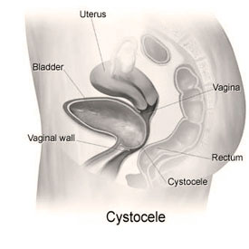
Cystocele
http://www.bing.com/images/search?q=cystocele&view=detail&id=0759FAD416CC24C63DF0FB07FBC38A3B3A2B00BD&first=1

Slide 25
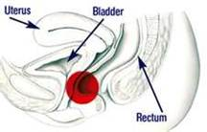
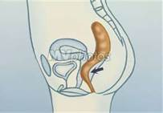
Rectocele
http://www.bing.com/images/search?q=rectocele&qs=n&form=QBIR&pq=rectocele&sc=8-9&sp=-1&sk=

Slide 26
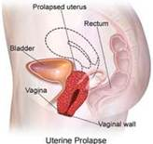
Uterine Prolapse
http://www.bing.com/images/search?q=uterine+prolapse&qs=n&form=QBIR&pq=uterine+prolapse&sc=8-11&sp=-1&sk=

Slide 27
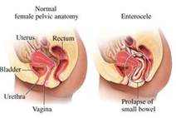
Enterocele
http://www.bing.com/images/search?q=enterocele&qs=n&form=QBIR&pq=enterocele&sc=0-0&sp=-1&sk=

Slide 28
Bladder Cancer
Risk Factors: cigarette smoking, exposure to industrial dyes or solvents
Second most common urologic cancer
Mean age at diagnosis is 65 years
Men > women (2.7:1)
Most commonly presents with hematuria (gross or microscopic, chronic or intermittent)

Slide 29
Symptoms/Signs of Bladder Cancer
Hematuria
Irritative voiding symptoms (frequency & urgency)
Masses detected on bimanual examination
Hepatomegaly or palpable lymphadenopathy, lymphedema of lower extremities in patients with metastatic disease

Slide 30
Lab Findings – Bladder Cancer
Urinalysis: microscopic/gross hematuria, pyuria
Anemia due to chronic blood loss or bone marrow metastases
Urine cytology is sensitive in detecting higher grade and stage lesions but less so in detecting superficial, low-grade lesions
Azotemia, ↑ creatinine due to ureteral obstruction

Slide 31
Bladder Cancer Diagnosis
Imaging: may be detected using ultrasound, CT or MRI where filling defects may be noticed
Diagnosis cannot be ruled out with imaging
Gold Standard: cystoscopy & biopsy of lesion

Slide 32
Pathology of Bladder Cancer
Most common: urothelial cell carcinomas
Rare in the US: squamous cell carcinoma (associated with schistosomiasis, bladder calculi or chronic catheter use) & adenocarcinoma
Bladder CA staging based on the extent of bladder wall penetration & either regional or distant metastases
Bladder CA grading based on histologic appearance: size, pleomorphism, mitotic rate & hyperchromatism
Frequency of recurrence & progression strongly correlated with grade

Slide 33
Treatment of Bladder Cancer
Transurethral resection of bladder tumor
  Initial tx for all bladder cancers
  Diagnostic & allows for proper staging
  Controls superficial cancers

Slide 34
Cystectomy
Cystectomy
  Treatment for muscle infiltrating cancers
  Partial cystectomy: for pts with solitary lesions or cancers in a bladder diverticulum
  Radical cystectomy: bilateral pelvic lymph node dissection, removal of bladder, prostate, seminal vesicles & surrounding fat/peritoneal attachments in men & in women also the uterus, cervix, urethra, anterior vaginal vault & usually the ovaries

Slide 35
Prognosis-Bladder Cancer
At initial presentation, approximately 50-80% of bladder cancers are superficial
Lymph node metastases & progression are uncommon in such patients when properly treated & survival is excellent at 81%
Long-term survival for patients with metastatic disease at presentation is rare

Slide 36

Questions?

Slide 37
References
Current Medical Diagnosis & Treatment (Lange)
The 5-Minute Urology Consult (Gomella)
Smith’s General Urology (Lange)
http://emedicine.medscape.com

